Slide 1
Programming Fundamentals
By
Shazmeen Batool

Slide 2
Previous Lecture
Array as a Member of Structure
Array of Structures
Nested Structures

Slide 3
Today’s Lecture
Structures and Functions
Structures and Pointers

Slide 4
Structures and Function

Slide 5
Structure Members as Function Arguments
Structure variables may be passed as arguments to functions.
Like other variables, the individual members of a structure variable may be used as function arguments.

Slide 6
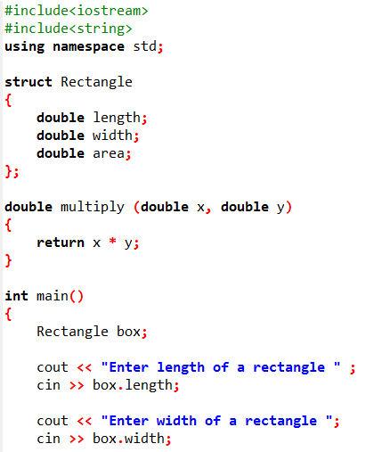


Slide 7
Structure as Function Arguments
Sometimes it’s more convenient to pass an entire structure variable into a function instead of individual members.

Slide 8
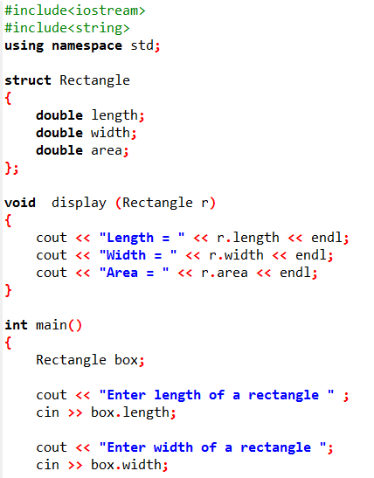


Slide 9
Structure as Reference Parameter

Slide 10
Structure as Reference Parameter
Structures can be passed by reference just as other simple types.
When a structure is passed by reference the called function declares a reference for the passed structure and refers to the original structure elements through its reference.
Thus, the called function works with the original values.

Slide 11
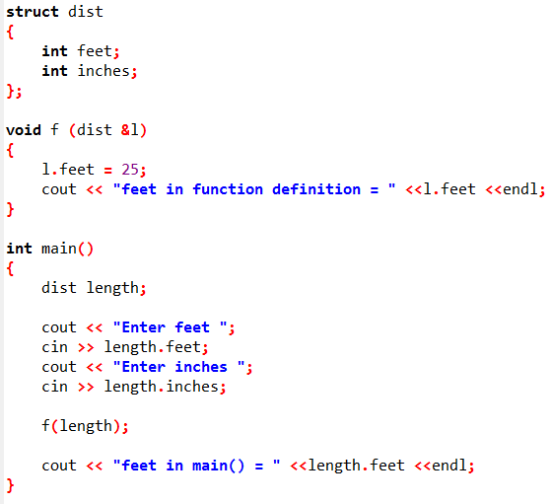

Slide 12
Constant Reference Parameters

Slide 13
Constant Reference Parameters
Sometimes structures can be quite large. Passing large structures by value can decrease a program’s performance because a copy of the structure has to be created.
When a structure is passed by reference, however, it isn’t copied.
A reference that points to the original argument is passed instead. So, it’s often preferable to pass large objects such as structures by reference.

Slide 14
Constant Reference Parameters
Of course, the disadvantage of passing an object by reference is that the function has access to the original argument. It can potentially alter the argument’s value.
This can be prevented, however, by passing the argument as a constant reference.

Slide 15
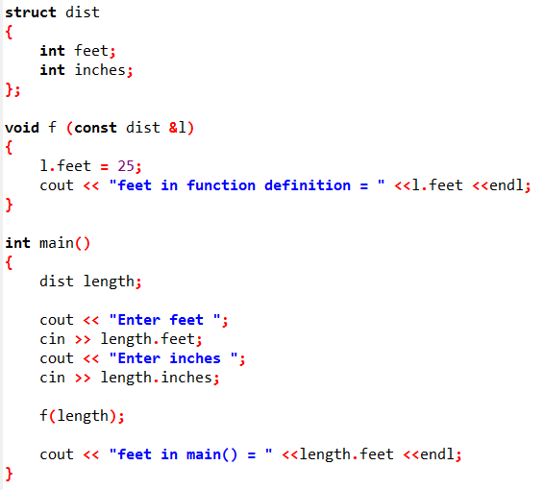

Slide 16
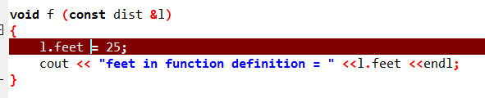


Slide 17
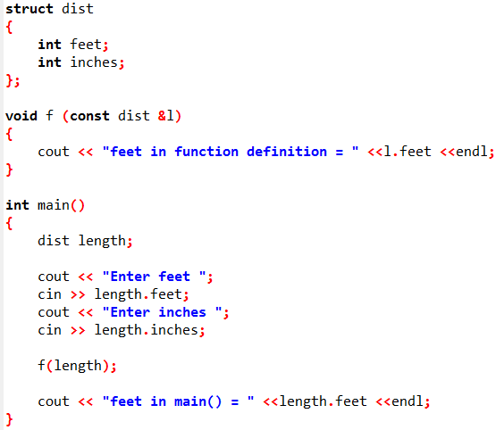


Slide 18
Returning Structure from Function

Slide 19
Returning Structure from Function
A function may return a structure.
Just as functions can be written to return an int, long, double, or other data type, they can also be designed to return a structure.

Slide 20
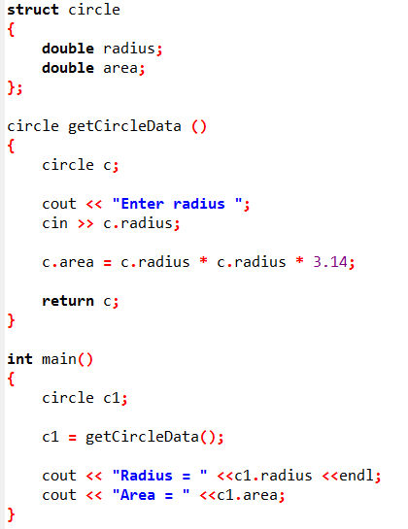

Slide 21
Returning Structure from Function
Notice that the getCircleData() function has a return data type of circle.
That means the function returns an entire circle structure when it terminates.
The return value can be assigned to any variable that is of type circle.

Slide 22
Pointers to Structures

Slide 23
Pointers to Structures
You may take the address of a structure variable and create variables that are pointers to structures.
C++ has a special operator for dereferencing structure pointers. It’s called the structure pointer operator, and it consists of a hyphen (-) followed by the greater-than symbol (>).
The structure pointer operator is supposed to look like an arrow, thus visually indicating that a “pointer” is being used.

Slide 24
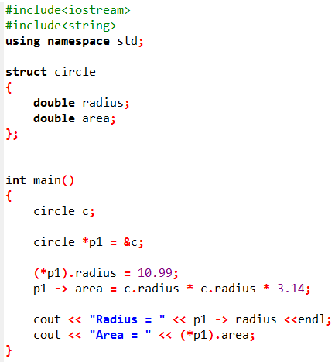

Slide 25
Pointers to Structures
The structure pointer operator takes the place of the dot operator in statements using pointers to structures. The operator automatically dereferences the structure pointer on its left. There is no need to enclose the pointer name in parentheses.

Slide 26
Next Lecture
File Handling

